Slide 1
MCA105-Operating System

Slide 2
Agenda
File allocation
Free space management
Disk Management

Slide 3
Allocation Methods
An allocation method refers to how disk blocks are allocated for files:
Contiguous allocation
Linked allocation
Indexed allocation

Slide 5
Contiguous Allocation
Each file occupies a set of contiguous blocks on the disk
Simple – only starting location (block #) and length (number of blocks) are required
Random access
Wasteful of space (dynamic storage-allocation problem)
Files cannot grow

Slide 6
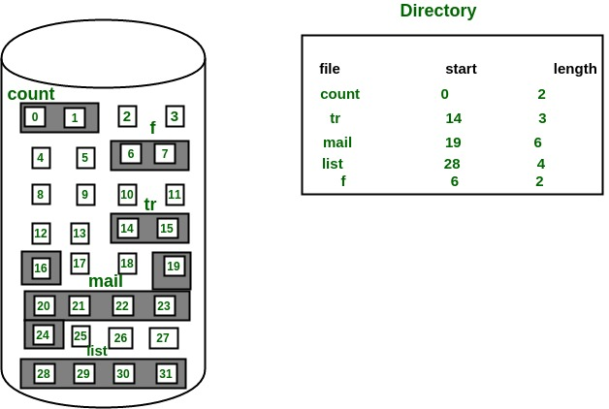
Contiguous Allocation of Disk Space

Slide 8
Linked Allocation
Each file is a linked list of disk blocks: blocks may be scattered anywhere on the disk.
block =
pointer

Slide 10
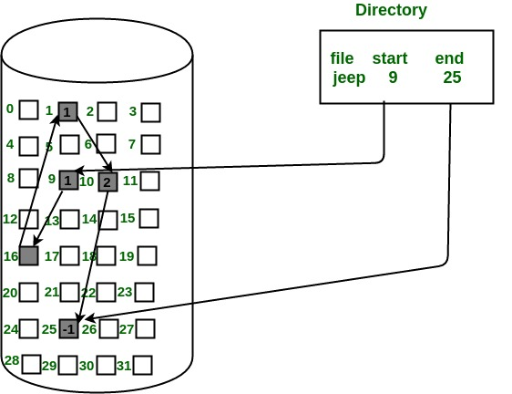
Linked Allocation

Slide 11
In this scheme, each file is a linked list of disk blocks which need not be contiguous.
The disk blocks can be scattered anywhere on the disk. The directory entry contains a pointer to the starting and the ending file block.
Each block contains a pointer to the next block occupied by the file.
The file ‘jeep’ in following image shows how the blocks are randomly distributed.
The last block (25) contains -1 indicating a null pointer and does not point to any other block.

Slide 12
Indexed Allocation
Brings all pointers together into the index block.
Logical view.
index table

Slide 13
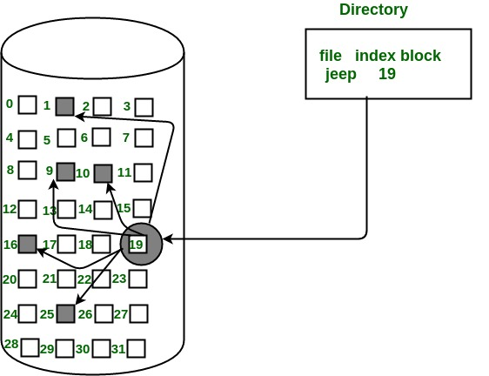
Example of Indexed Allocation

Slide 14
In this scheme, a special block known as the Index block contains the pointers to all the blocks occupied by a file.
Each file has its own index block.
The ith entry in the index block contains the disk address of the ith file block.
The directory entry contains the address of the index block as shown in the image:

Slide 15
Indexed Allocation (Cont.)
Need index table
Random access
Dynamic access without external fragmentation, but have overhead of index block.

Slide 16
Indexed Allocation – Mapping (Cont.)

outer-index
index table
file

Slide 17
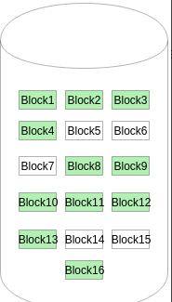
Free-Space Management
File system maintains free-space list to track available blocks/clusters
(Using term “block” for simplicity)
Bit vector or bit map (n blocks)
The given instance of disk blocks on the disk in Figure (where green blocks are allocated) can be represented by a bitmap of 16 bits as: 0000111000000110.

Slide 18
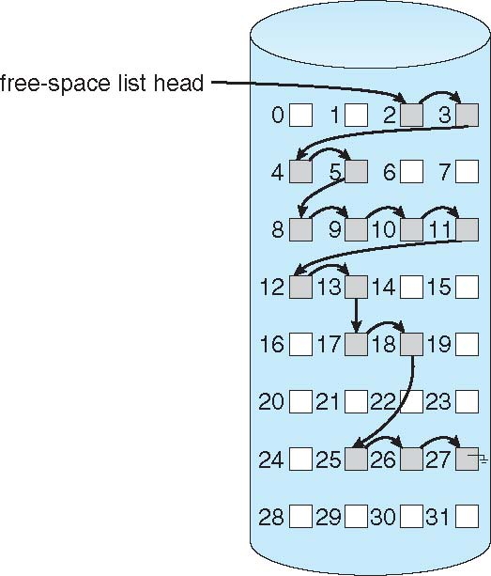

Linked Free Space List on Disk
Linked list (free list)
Cannot get contiguous space easily
No waste of space
No need to traverse the entire list (if # free blocks recorded)

Slide 19
Free-Space Management (Cont.)
Grouping
This approach stores the address of the free blocks in the first free block. The first free block stores the address of some, say n free blocks. Out of these n blocks, the first n-1 blocks are actually free and the last block contains the address of next free n blocks.
Counting
Because space is frequently contiguously used and freed, with contiguous-allocation, extents, or clustering
Keep address of first free block and count of following free blocks
Free space list then has entries containing addresses and counts

Slide 20
Disk Management

Slide 21
Mass-Storage Structure
Magnetic Disks
Relatively simple
Disk platter has a flat circular shape
Platter diameter can be between 1.8 to 5.25 inches
Surfaces are covered with magnetic material
Stores information by recording it magnetically on the platters

Slide 22
Structure of a Magnetic Disk
Spindle
Arm assembly
Platter
Track (t)
Cylinder (c)
Read-write head
Sector (s)
Arm

Slide 23
Mass-Storage Structure
Magnetic Tapes
Early Storage Mechanism
Is relatively permanent and can hold large quantities of data
Access Time is slow compared with that of main memory and magnetic disks
Random access to magnetic tapes are very slower than random access to magnetic disks
Not very useful for secondary storage
Mainly used for backup, infrequently used data, or as a medium of data transfer
Storage – typically, 20 GB to 200 GB

Slide 24
Disk Attachment
Computers access disk storage in two ways:
Via Input-Output Ports (host-attached storage)
Common on small systems
Examples: hard disk drives, RAID arrays, CD, DVD, tapes, etc.
Via a Remote Host in a Distributed File System (network-attached storage)
Special purpose storage system accessed over a data network
Clients access NAS via remote procedure call interface
A special case – Storage Area Network (SAN)

Slide 25
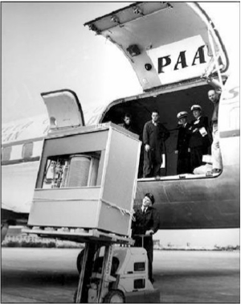
The First Commercial Disk Drive
1956
IBM RAMDAC computer included the IBM Model 350 disk storage system
5M (7 bit) characters
50 x 24” platters
Access time = < 1 second

